Slide 1
Industry and Competitor Analysis
Chapter 5

Slide 2
What is Industry Analysis?
Industry
An industry is a group of firms producing a similar product or service, such as airlines, drinks, furniture, or electronic games.
Industry Analysis
A market assessment tool designed to provide a business with an idea of the complexity of a particular industry. Industry analysis involves reviewing the economic, political and market factors that influence the way the industry develops. Major factors can include the power wielded by suppliers and buyers, the condition of competitors, and the likelihood of new market entrants.

Slide 3
Why is Industry Analysis Important?
Importance
Once it is determined that a new
venture is feasible in regard to the
industry and market in which it
will compete, a more in-depth
analysis is needed to learn the ins
and outs of the industry.
The analysis helps a firm determine
if the target market it identified
during feasibility analysis is
favorable for a new firm.
Industry Analysis

Slide 4
Key Questions
To develop a sound strategic plan for an existing or a new business it is necessary to understand the industry in which the business will operate and the competitive forces within that industry. Questions to be answered include the following:
Is the industry accessible—in other words, is it a realistic place for a new venture to enter?
What is the current size and what are the major trends in the industry?
What are the main competitive forces?
Who are the competitors and what are their relative strengths?

Slide 5
Techniques Available to Assess Industry Attractiveness
Assessing Industry Attractiveness
Study Environmental
and Business Trends
Industry Life Cycle
The Five Competitive
Forces Model

Slide 6
Studying Industry Trends
Environmental Trends
Include economic trends, social trends, technological advances, and political and regulatory changes.
For example, industries that sell products to seniors are benefiting by the aging of the population.
Business Trends
Other trends that impact an industry.
For example, are profit margins in the industry increasing or falling? Is innovation accelerating or waning? Are input costs going up or down?

Slide 7



“By 1976 Kodak accounted for 90% of film and 85% of camera sales in America. Until the 1990s it was regularly rated one of the world’s five most valuable brands”. In fact, In 1996, Kodak was ranked the world’s fourth most-valuable brand behind Disney, Coca-Cola and McDonald’s….
In 1998, Kodak had 170,000 employees and sold 85% of all photo paper worldwide.
Within just a few years, their business model disappeared and they got bankrupt.
What happened to Kodak will happen in a lot of industries in the next 10 years – and most people don’t see it coming. Did you think in 1998 that 3 years later you would never take pictures on paper film again?

Slide 8
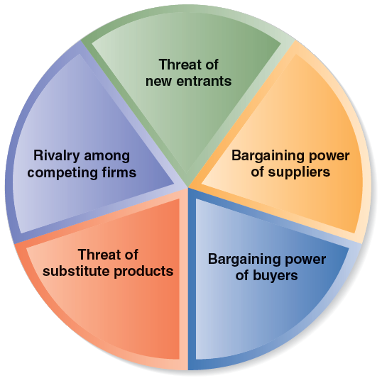
Porter's Five Forces Analysis
It is an outside-in business strategy tool that is used to make an analysis of the attractiveness (value...) of an industry structure developed by Michael E. Porter of Harvard Business School in 1979.

Slide 9
Threat of Substitute Products
The threat of substitute products increases when:
Buyers face few switching costs.
The substitute product’s price is lower.
Substitute product’s quality and performance are equal to or greater than the existing product.
For example, there are few if any substitutes for prescription medicines, which is one of the reasons the pharmaceutical industry is so profitable.
Differentiated industry products that are valued by customers reduce this threat.
Notes:
If the price gets too high,
businesspeople will increasingly utilize videoconferencing as a substitute for
travel. This problem is particularly acute if the substitutes are free or nearly
free. For example, if the price of express mail gets too high, people will
increasingly attach documents to e-mail messages rather than sending them
via UPS or FedEx.

Slide 10


Firms often offer their customers amenities to reduce the likelihood that they will switch to a substitute product, even in light of a price increase.
A customer could easily get
a cup of coffee cheaper at
one of Starbuck’s competitors.
To decrease the likelihood of
this, Starbucks offers high-
quality fresh coffee, good
service, and a pleasant
atmosphere.
Starbucks has therefore
reduced the threat of
substitutes.

Slide 11
Threat of New Entrants
Threat of New Entrants
If the firms in an industry are highly profitable, the industry becomes a magnet to new entrants.
Unless something is done to stop this, the competition in the industry will increase, and average industry profitability will decline.
Firms in an industry try to keep the number of new entrants low by erecting barriers to entry.
A barrier to entry is a condition that creates a disincentive for a new firm to enter an industry.

Slide 12
Non Traditional Barriers to Entry
It is difficult for start-ups to execute barriers to entry that are expensive, such as economies of scale, because money is usually tight.
Start-ups have to rely on nontraditional barriers to entry to discourage new entrants, such as assembling a world-class management team that would be difficult for another company to replicate.

Slide 13
Rivalry Among Existing Firms
Rivalry Among Existing Firms
In most industries, the major determinant of industry profitability is the level of competition among existing firms.
Some industries are fiercely competitive, to the point where prices are pushed below the level of costs, and industry-wide losses occur.
In other industries, competition is much less intense and price competition is subdued.

Slide 14
Bargaining Power of Suppliers
Bargaining Power of Suppliers
Suppliers can suppress the profitability of the industries to which they sell by raising prices or reducing the quality of the components they provide.
If a supplier reduces the quality of the components it supplies, the quality of the finished product will suffer, and the manufacturer will eventually have to lower its price.
If the suppliers are powerful relative to the firms in the industry to which they sell, industry profitability can suffer.

Slide 15
Bargaining Power of Buyers
Buyer power increases when:
Buyers are large and few in number.
Buyers purchase a large portion of an industry’s total output.
Wal*Mart is a powerful organization and bargains hard with its suppliers to obtain better prices
Buyers can pose threat to integrate backward into the sellers’ industry.
Buyer has full information.
Monopsony..?

Slide 16
Industry Life Cycle
Reflects the changes that take place in an industry over time.
Birth stage: firms seek to develop a winning technology.
For example, in the personal computer industry, this stage would have been in the early-to-mid 1980s as companies explored the possibilities of selling these devices.
Growth stage: Product gains customer acceptance and grows rapidly.
New firms enter industry, production improves, distributors emerge.
Shakeout stage: The stage between growth and maturity.
Competitor rivalry increases.
Least efficient firms fail and leave industry.

Slide 17
When should I join an industry?
Joining an industry in the “Birth” or “Growth” stage has the greatest potential to grow YET there are chances that the business you joined will fail.
The best time to join an industry is in the Shakeout stage (Point X). The business concept is proven and markets are pioneered. This is when the strong companies strengthen their businesses and sales explode.
Maturity stage: most customers have bought the product, growth is slow.
Relationships between suppliers, distributors more stable.
Usually, industry dominated by a few, large firms.
Decline stage: falling demand for the product.
Prices fall, weaker firms leave the industry.

Slide 18
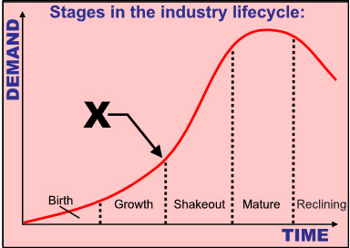

Slide 19
Competitor Analysis
What is a Competitor Analysis?
A competitor analysis is a detailed analysis of a firm’s competition.
It helps a firm understand the positions of its major competitors and the opportunities that are available.
A competitive analysis grid is a tool for organizing the information a firm collects about its competitors.

Slide 20
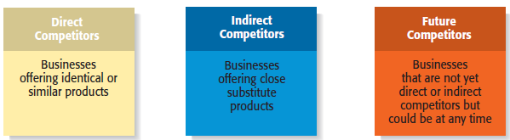
Identifying Competitors
Types of Competitors New Ventures Face

Slide 21
Sources of Competitive Intelligence
Collecting Competitive Intelligence
To complete a competitive analysis grid, a firm must first understand the strategies and behaviors of its competitors.
The information that is gathered by a firm to learn about its competitors is referred to as competitive intelligence.
A new venture should take care that it collects competitive intelligence in a professional and ethical manner.

Slide 22
Sources of Competitive Intelligence
Ethical ways to obtain information about competitors
Attend conferences and trade shows.
Purchase competitors’ products.
Study competitors’ Web sites.
Set up Google and Yahoo! e-mail alerts.
Read industry-related books, magazines, and Web sites.
Talk to customers about what motivated them to buy your
product as opposed to your competitor’s product.

Slide 23
Competitive Profile Matrix (CPM)- It compares the company with direct competitors and check whether company is doing well as compared to competitors or not.
Competitive profile matrix is essential tool used in strategic management process, it contain all the important critical success factors of industry. Success factor can vary form industry to industry, every industry consider different success factor, all the companies in CPM are measured on same scale by considering the same success factor.

